Slide 1

GROUP MEMBERS GANESH KAJA (00868492) VAISHNAVI CHOWDARY KOMMI (00869093)

Slide 2
TIC TAC TOE
Tic-Tac-Toe is a simple two-player game played on a 3x3 grid, where players take turns marking cells with "X" or "O" to form a line of three of their symbols either horizontally, vertically, or diagonally. The game ends in a win for the first player to achieve this or in a draw if the grid fills up without a winner.
Implementation of multiple Tic – Tac – Toe agents using below algorithms
Sparse Sampling
Rollout Policy Adaptation
Temporal Difference Learning

Slide 3
STATEMENT OF PROJECT OBJECTIVES
Developing three AI agents:
Sparse Sampling: Uses Tree Search approach
Rollout Policy Adaptation: Uses Monte Carlo approach
Temporal Difference Learning: Uses Reinforcement Learning approach
Objective: Design AI agents to excel in Tic-Tac-Toe by awarding points to players who achieve three consecutive symbols in a row, column, or diagonal.
Methodology:
Develop and compare AI agents based on Temporal Difference Learning, Rollout Policy Adaptation (Monte Carlo), and Sparse Sampling (Tree Search) algorithms.
Evaluate the effectiveness of each algorithm in achieving the goal of winning Tic-Tac-Toe games against human opponents.
Investigate and analyze the performance of the AI agents in terms of their learning speed, efficiency, and ability to adapt to different game scenarios.

Slide 4
APPROACH
Techniques Used:
Temporal Difference Learning: Implement to create an agent learning from immediate rewards and anticipated future rewards to make optimal moves.
Rollout Policy Adaptation (Monte Carlo): Employ random simulations to approximate the value of actions, aiding in decision-making for optimal moves.
Sparse Sampling (Tree Search): Utilize efficient exploration of the search space to determine optimal moves, particularly suited for games with large state spaces.
Tools used: VS Code

Slide 5
DELIVERABLES
Proposal Presentation: Explanation of the project, approach, and evaluation methodology
Detailed presentation outlining the implementation of Tic Tac Toe using Min-Max and Reinforcement Learning agents
YouTube video: Demonstrating the project and execution of the code
GitHub repository: Documentation, final working code, required resources, YouTube video, and other reference links.

Slide 6
EVALUATION METHODOLOGY
The project's success relies on effectively implementing three AI agents:
Temporal Difference Learning: Update value estimates to make optimal moves.
Key Evaluation Criteria:
No. of Episodes: Number of episodes/games played for evaluation.
Regret: Measure of how much an agent regrets its actions, indicating how well it has learned optimal strategies.
Average Total Rewards per Episode: Measure of the average rewards accumulated by each agent per episode.
Win Rate: Percentage of games won by each agent.
Learning Speed: Rate of improvement observed over time.
Adaptability: Performance across different game scenarios and opponents.
Sparse Sampling (Tree Search): Efficient exploration of the search space for optimal moves.
Rollout Policy Adaptation (Monte Carlo): Employ random simulations for decision-making.
Efficiency: Determining the most efficient algorithm through rigorous evaluation and analysis.

Slide 7
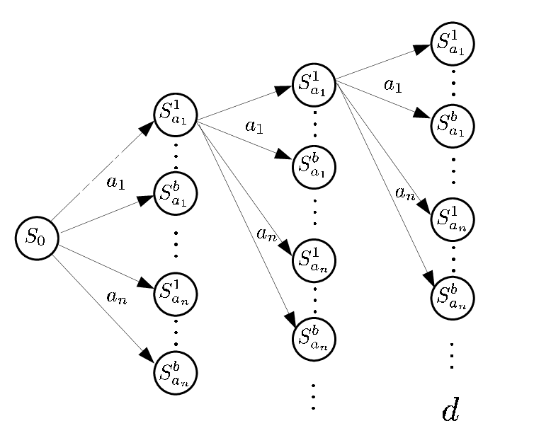
SPARSE SAMPLING
SPARSE SAMPLING
Practice of collecting or analyzing data or information in a way that involves selecting only a small subset of the available data rather than examining or collecting all of it.
This approach is often used when dealing with large datasets or complex systems to reduce computational resources or to focus attention on key areas of interest.

Slide 8
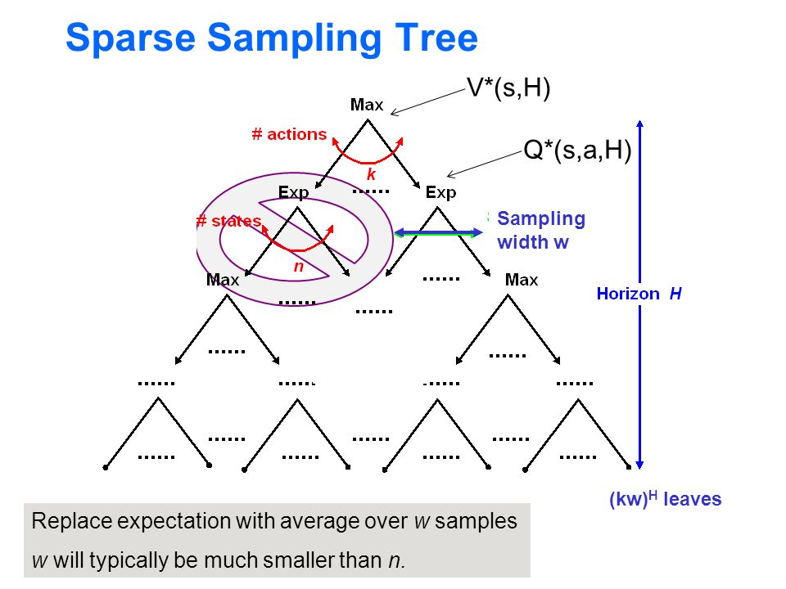

Slide 9
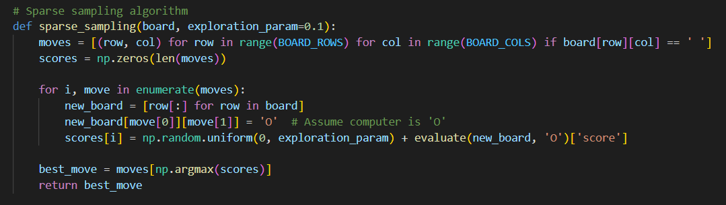
SPARSE SAMPLING
CODE SNIPPET

Slide 10
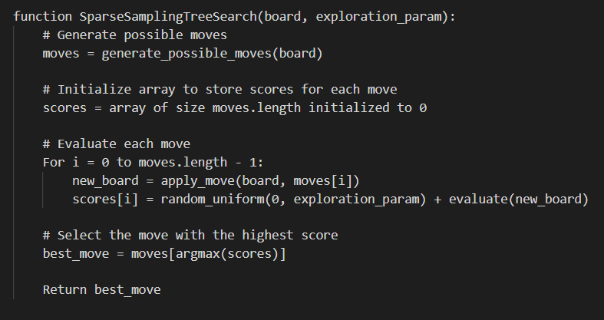
Pseudocode

Slide 11
SPARSE SAMPLING
ROLLOUT POLICY
Start
|
Select subset of actions
|
Evaluate potential outcomes
|
Choose best course of action
|
End
Rollout policy: A focused decision-making approach selecting key actions, streamlining complex scenarios. Prioritizes resources for efficiency. Like data subset selection, optimizes resources for informed decisions.
"Rollout policy ensures efficient navigation through intricate decision spaces, enhancing decision-making effectiveness in complex environments."

Slide 12
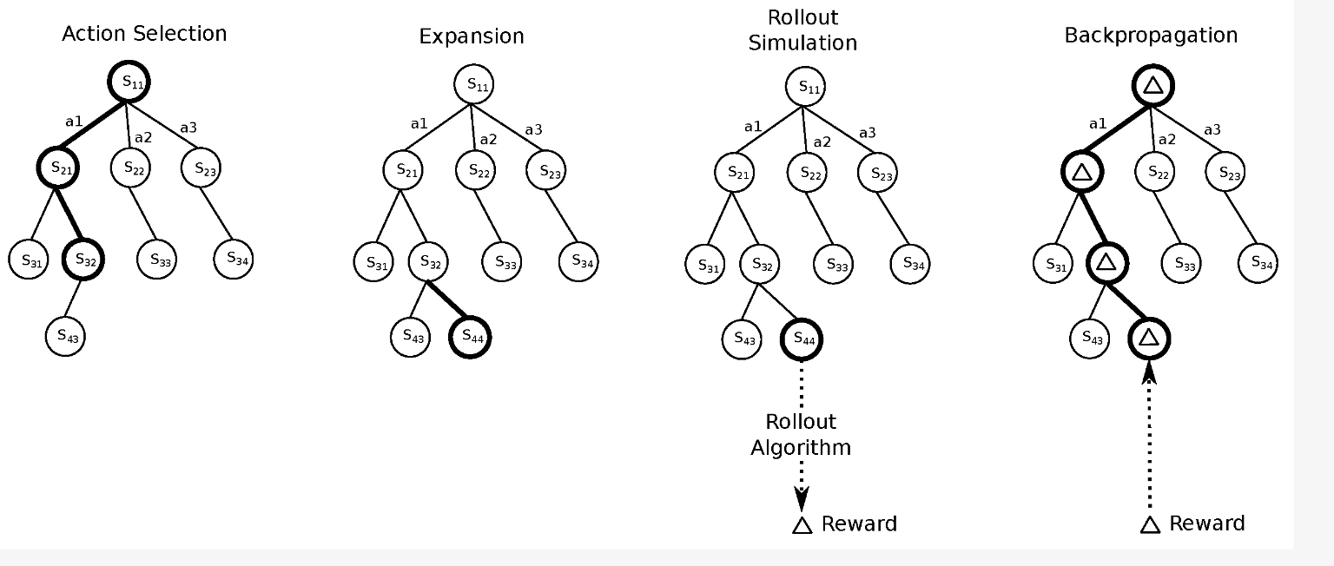

Slide 13
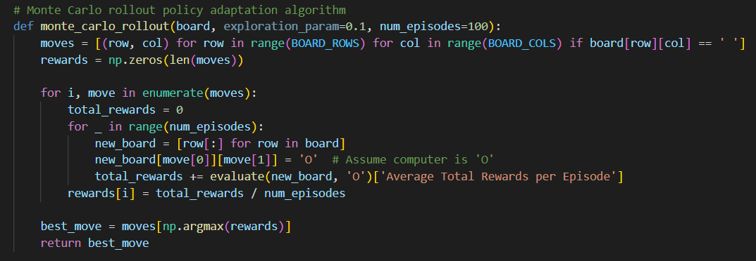
SPARSE SAMPLING
CODE SNIPPET

Slide 14
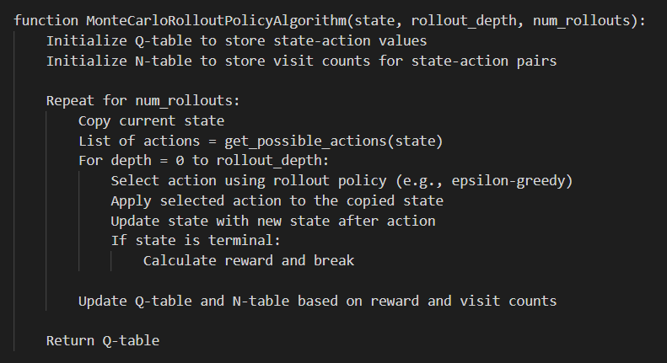
SPARSE SAMPLING
PSEUDOCODE

Slide 15
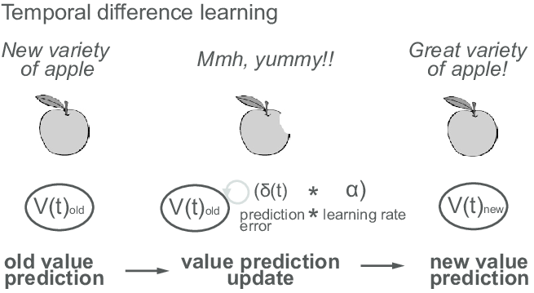
SPARSE SAMPLING
TEMPORAL LEARNING
Temporal learning refers to a branch of machine learning focused on understanding and modeling data that evolves over time. It involves analyzing sequential data to capture patterns, trends, and dependencies that change with time.
Temporal learning algorithms are designed to handle time-series data, sequential data, or any data with a temporal component, enabling tasks such as time series forecasting, sequence prediction, and temporal pattern recognition.

Slide 16
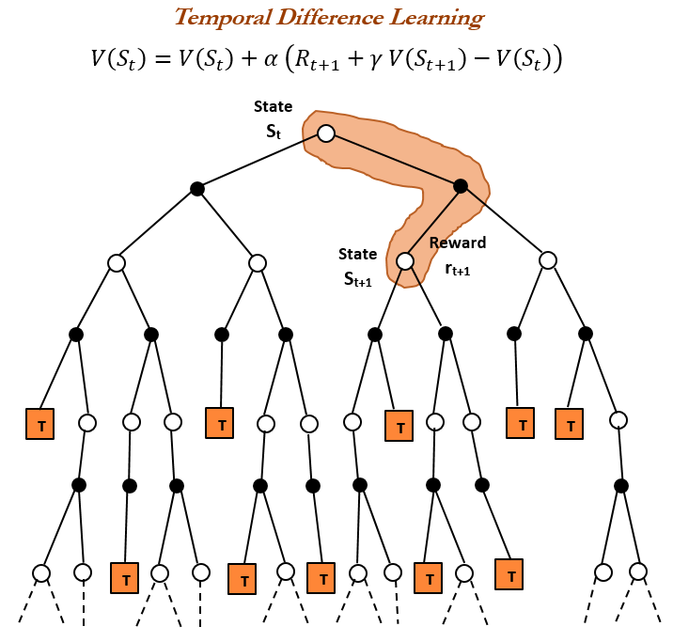

Slide 17
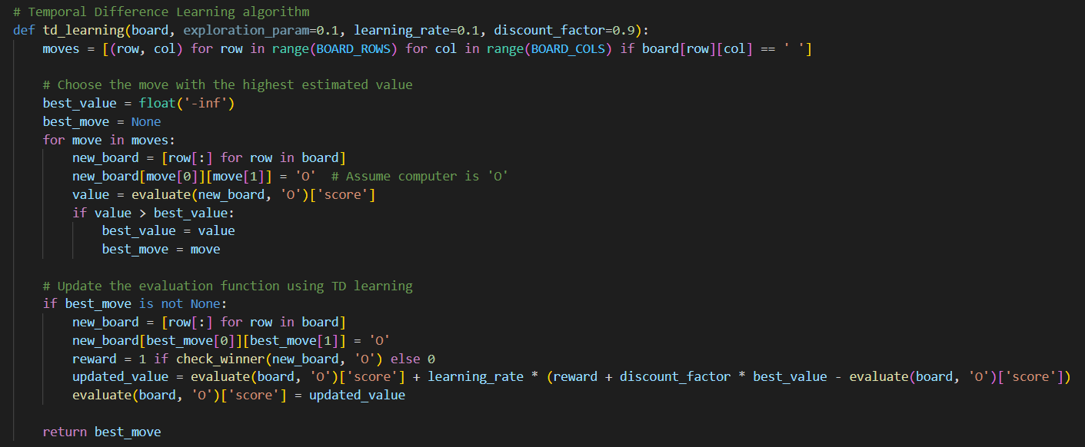
SPARSE SAMPLING
CODE SNIPPET

Slide 18
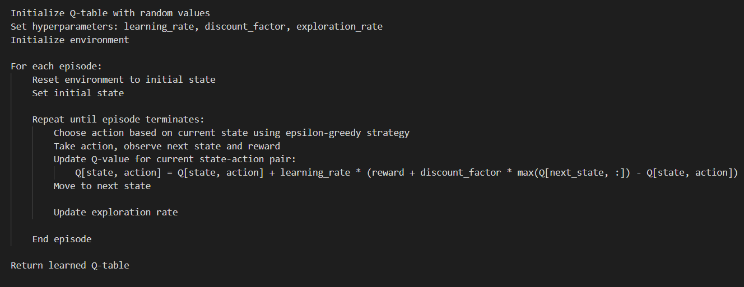
SPARSE SAMPLING
PSEUDOCODE

Slide 19

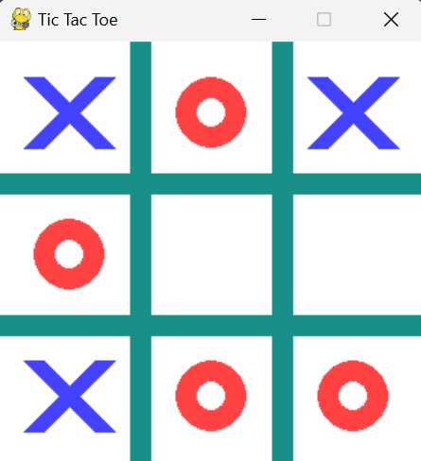
SPARSE SAMPLING
RESULTS

Slide 20
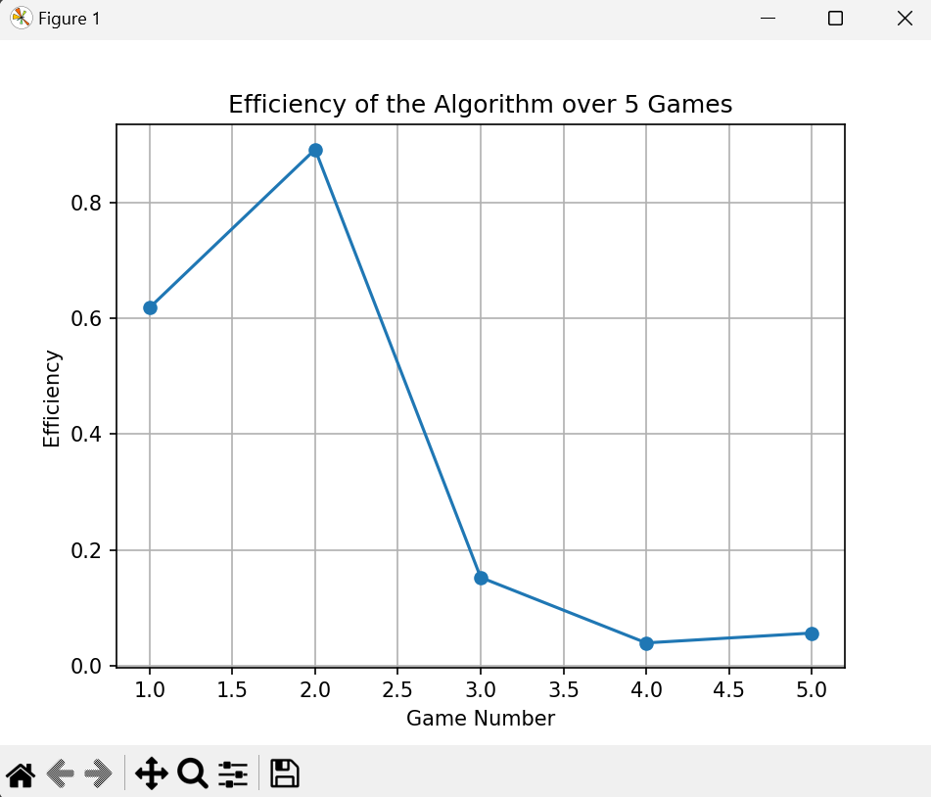
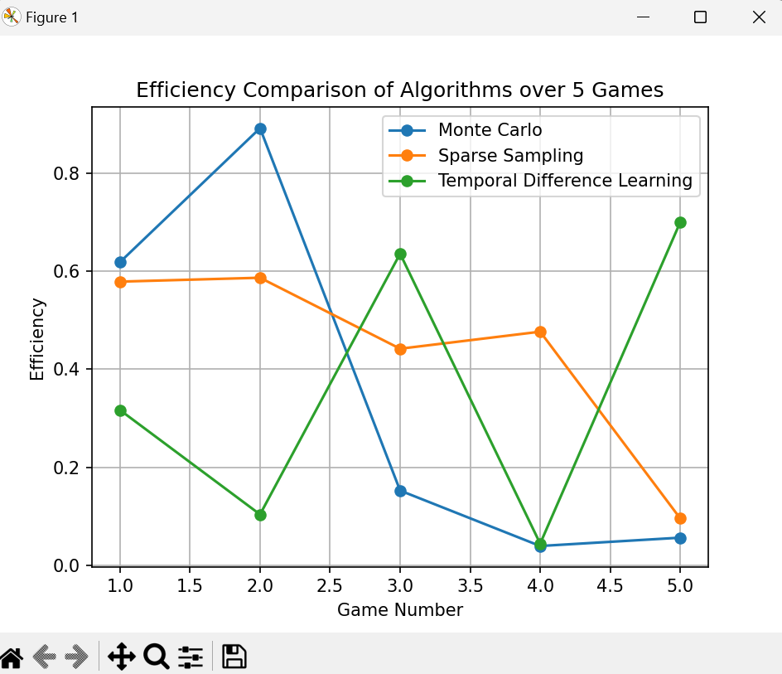
SPARSE SAMPLING
RESULTS

Slide 21
SPARSE SAMPLING
REFERENCES
Sparse Tree Search Optimality Guarantees in POMDPs with Continuous Observation Spaces: https://www.ijcai.org/proceedings/2020/0572.pdf
https://martin-ueding.de/posts/tic-tac-toe-with-monte-carlo-tree-search/
https://www.synopsys.com/ai/what-is-reinforcement-learning.html
Rollout and Approximate Policy Iteration: https://web.mit.edu/dimitrib/www/RLTopics_Lecture3.pdf

Slide 22
LETS RUN THE CODE!

Slide 23

THANK YOU

